Slide 1

Introduction to Curves
Chapter 5
12 Marks

Slide 2
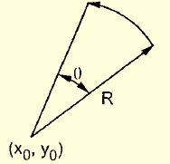
Circular curve generation using DDA algorithm
We make use of DDA circle Drawing algorithm.
Instead of drawing complete circle we just draw some portion.
x = x₀ + R cos Ɵ
y = y₀ + R Sin Ɵ
Where x₀, y₀ is centre of curvature and R is radius.

Slide 3
Circular curve generation using DDA algorithm
Where Ɵ will be stepping angle.
We have to find start point (x₁, y₁) and end point (x₂,y₂) of curve by increasing Ɵ by stepping value
We are not using symmetry property of circle, since we simply plot some portion of circle.

Slide 4
Problems in true curve generation approach
To specify a curve we need more information than its endpoints.
It is difficult to apply transformations.
Clipping will be difficult for curves
Curves other than circular or elliptical are difficult to construct using this method.

Slide 5
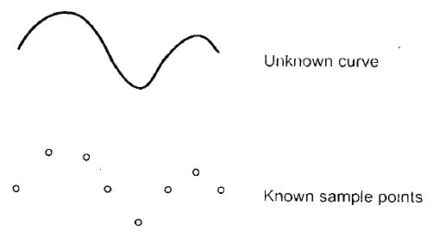
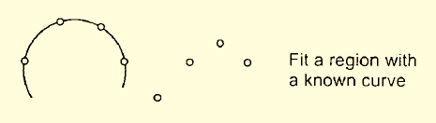
Interpolation

Slide 6
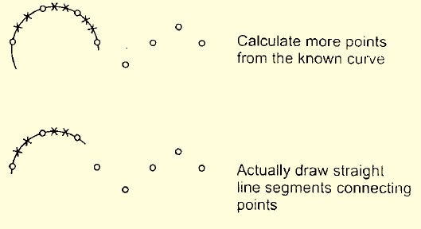
Interpolation Process

Slide 7
Interpolation
We use approximation to Some complex curves which don't have mathematical function
If we have set of sample points which lie on the required curve then curve can be drawn by filling portions of curve with pieces of known curve.
Gap between sample points can be filled by finding the coordinates of the points along the known approximating curve and connecting these points

Slide 8
Interpolation
Polynomial functions in the parametric form are preferred to represent known curve
The polynomial functions in parametric form given as
x = f_{x}(u) y = f_{y}(u) z = f_{z}(u)
Intermediate points between sample points are determined using interpolation technique.
A polynomial curve pass through n sample points
(x₁, y₁, z₁), (x₁, y₁, z₁), ...., (x₁, y₁, z₁)

Slide 9
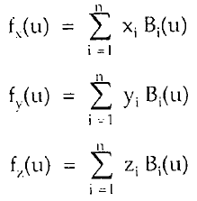
Interpolation
we construct function as sum of terms, one term for each sample points
The function B_{i}(u) called Blending function.
For each value of u blending function determines how much i^{th} sample point affects the position of curve

Slide 10
Cont….
Each sample points tries to pull the curve in its direction and function B_{i}(u) gives strength to pull
For some values of u, B_{i}(u)=1 for unique value of i, then i^{th} sample point has complete control and curve pass through i^{th} point.
Assume first sample point (x1,y1,z1) has complete control when u=-1, second when u=0, third when u=1 and so on

Slide 11
When u=-1 → B₁(u) = 1 and 0 for u=0,1,2..n-2
When u=0 → B₂(u) = 1 and 0 for u=-1,1,2..n-2
:
When u=(n-2) → B_{n}(u) = 1 and 0 for u=-1,0,2..n-1
To get B1(u)=1 at u=-1 and 0 for u=0,1,2,....n-2

Slide 12
Fractals
Natural objects has irregular shape
Very difficult to draw irregular shapes by normal equations
Natural objects described using fractals where procedures rather than equations are used to model objects
Self similarity is the property of fractals (when we zoom object, we keep seeing same structure)
Fractals are created using repetitive steps.
Every step depends upon previous step.

Slide 13
Application of Fractals
Space Research – study of galaxies, simulation of stars and their behaviour
Medical Science – analyzing bacteria cultures, study of jeans, human anatomy
Chemical Research – simulation of chemical reaction, molecules, atomic research,
Image processing
Art
Representation of clouds, coastline and borderlines,

Slide 14
Topological Dimension
Imagine an object that is made up of clay.
If we break in term of one line segment then we will give dimension D_{t}=1.
If object is broken into plane, then we will give dimension as D_{t}=2
If object is broken into 3D objects we will give dimension as D_{t}=3
Here variable D_{t} called topological dimension

Slide 15
5cm
Line having Length L = 5cm
Number of equal pieces (N) = 5
Each part length (l) = 1cm
Scaling factor is = 1/S
Where S is number of scaled objects
In this case S = 5
We can say N = S¹

Slide 16
Above square is scaled by ½ , then four small square get generated.
If we want to build the original square again, then we need N number of scaled objects (i.e 4)
So here S = 2 and N = 4
N = S²

Slide 17
Suppose we scaled cube as half, then we need 8 scaled objects to form original object
Here S=2 & N = 8
N = S³

Slide 18
Fractal Dimension
From observation of topological dimension examples there is relation of exponent & D_{t}
So we get generalized equation as
N = S^{Df}
If we scale an object by ‘S’ & must assemble ‘N’ of scaled objects to reconstruct the full sized/original object,
Then dimension D_{f} of object given by
D_{f} =

Slide 19
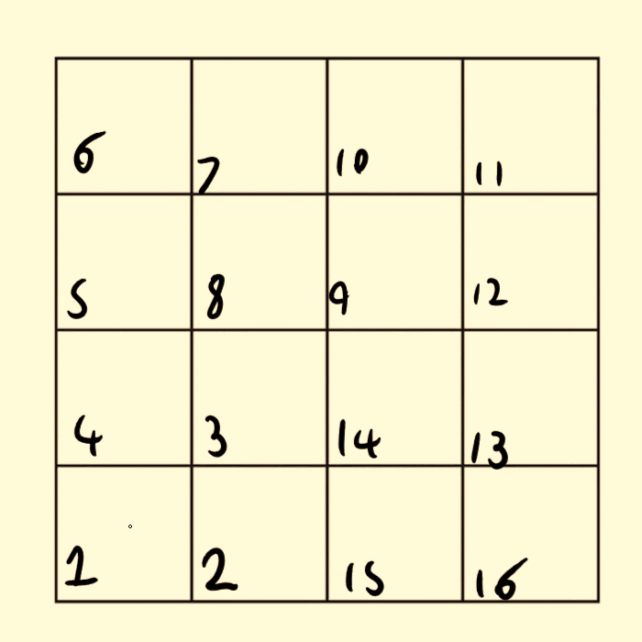
Hilbert’s Curve
Also called Peano curve
Easy to implement.
Curve begins with initial square
Generation of curve requires successive approximations

Slide 20
First Approximation of Hilbert curve
Divide the square into four quadrants and drawing the curve which connect centre points of each quadrants

Slide 21
Hilbert’s Approximations
Second Approximation of Hilbert’s Curve
Further subdivide each of four quadrants and draw the curve which connects centre point of each of these finer subdivisions before moving the next major quadrant
Third Approximation of Hilbert’s Curve
Again subdivides each quadrant and process continues.

Slide 23
Hilbert’s Curve
Curve is not getting overlap at any point.
There is no limit to subdivision
The curve fills the square.
Ideally the length of curve is infinite
With each subdivision length increased by factor 4.
Curve is equivalent to line, so D_{t}is 1
At each subdivision scale changes by 2; we need 4 scaled curves to form original curve.
4 = 2^{Df} D_{f}=2

Slide 24
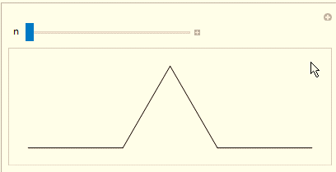
Koch Curve
Start with a line segment.
Divide line segment into three equal parts.
Replace central third part by two adjacent sides of equilateral triangle.

Slide 25
Koch curve
Koch curves end coordinates are as that of original segment, but it is built of 4 equal length segments of 1/3 of original length
New length of curve will be 4/3 (1st approximation)
After second approximation length becomes 16/9 times original
The length of Koch curve is infinite
The curve does not fill whole area as Hilbert’s curve

Slide 26
Cont…
Koch curve does not deviate from its original shape
If we reduce the scale of curve by 3 we find the curve looks like original one; but we must gather 4 such curves to make original
So 4 = 3^{Df}
D_{f} = 1.26
D_{t} = 1

Slide 27
Snowflakes
Koch curve is extended to generated snowflakes.
For generation of snowflake Koch curve is applied to each side of triangle.
Length of each edge of triangle goes on increasing with more and more roughness, in number of iteration.
Snowflake possess self similarity property of fractals.

Slide 29
Question Bank
Solve following question (2 Marks)
1. Define fractals…………………………………………(R )
What is interpolation…………………………….(R)
What is topological dimension………………(U)
List the problem in true curve generation algorithm………..(R )
What is fractal dimension …………………………………..(U)
What are the various method of curve drawing………(R )

Slide 30
Question Bank
Solve following questions (4 Marks)
Explain DDA arc generation algorithm ……………………..(U)
Write a short note on Bezier curve……………………….(U)
Describe Koch curve & give its fractal dimension……………(U)
List any four properties of Bezier curve…………………(R)
Explain Hilbert curve & give its fractal dimension ……(U)
Obtain the curve parameter for drawing a smooth Bezier curve for

Slide 31
Question Bank
6. following control points :
A (0,0 ), B(10,30), C(60,20) ,D(70,-20)……………………….(A)
7. Obtain the curve parameter for drawing a smooth Bezier curve for following control points :
A (0,0 ), B(10,40), C(70,30) ,D(60,-20)……………………..(A)
8. Construct the B- spline curve of order 4 & with 4 polygon vertices A(1,1 ), B( 2,3), C(4,3) & D(6,2)………………………….(.A)

Slide 32
Question Bank
9. Construct the Bezier curve of order 3 & 4 polygon vertices A(1,1), B(2,3),C(4,3) & D(6,4)……(A)

